Slide 1
Voting in the ND 2018 Midterms

Slide 2
Voting in ND
North Dakota is the only state in the U.S. that does not require voter registration.
However, there are other criteria that eligible voters must meet.

Slide 3
Scenario 1:
You have a North Dakota ID with your current address.
Items to bring to the polling location:
A valid North Dakota ID
  North Dakota Driver’s License
  North Dakota Nondriver ID
  Valid Tribal ID
  Long-term care certificate

Slide 4
Scenario 2:
You have a North Dakota ID with an out-of-date address.
What you need:
A valid North Dakota ID
  North Dakota Driver’s License
  North Dakota Nondriver ID
  Valid Tribal ID
  Long-term care certificate
A form of supplemental documentation
  Utility bill
  Government-issued document
  Bank statement

Slide 5
Scenario 3:
You have an out-of-state ID.
What you need to vote:
A North Dakota issued driver’s license or ID card
  The ID card is free of charge at the ND DOT, but getting it revokes your driving privileges in your home state.
  A ND driver’s license allows you to keep your driving privileges in your home state, but it will cost you $15, and you must have documentation that you have lived in the state for more than 90 days to qualify.
What you need to get a driver’s license or ID card:
Your out-of-state ID
Proof of your identity
  U.S. birth certificate
  U.S. passport
Proof of ND residency
  Government document
  Lease
$15 (if getting driver’s license)

Slide 6
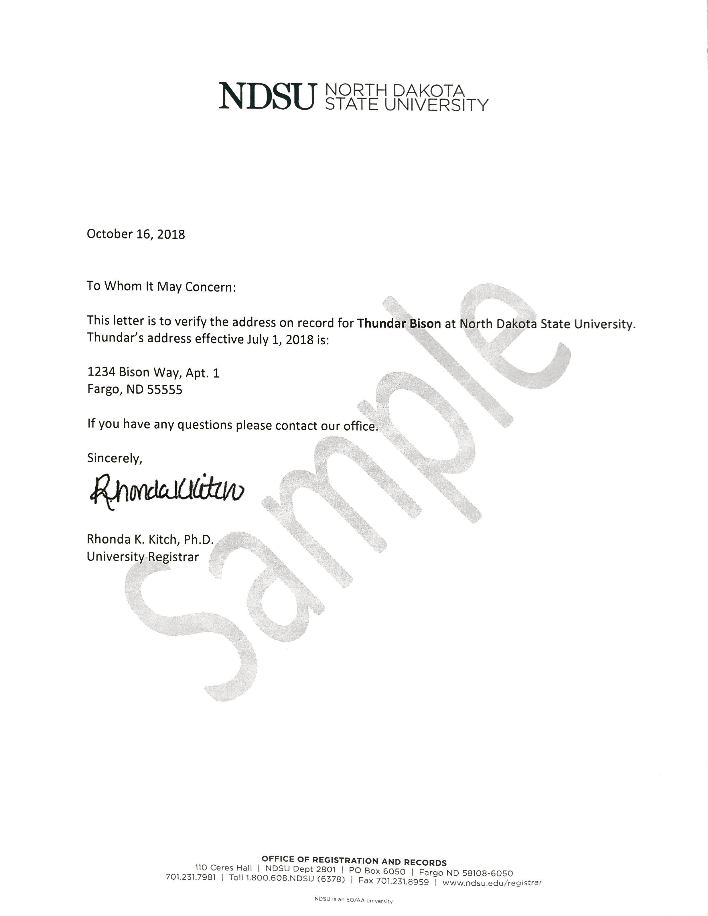
What ‘government document’ can verify my address?
NDSU Registration and Records office will provide student address confirmations on letterhead.
Students will need to present photo ID to Registration and Records staff.
The address is confirmed, with an effective date, from information in Campus Connection.
Questions may be directed to ndsu.registrar@ndsu.edu or
(701)231-7981.
This counts as a government document since we are a state university!
Other documents that will work include utility bills, paychecks, or bank statements.

Slide 7
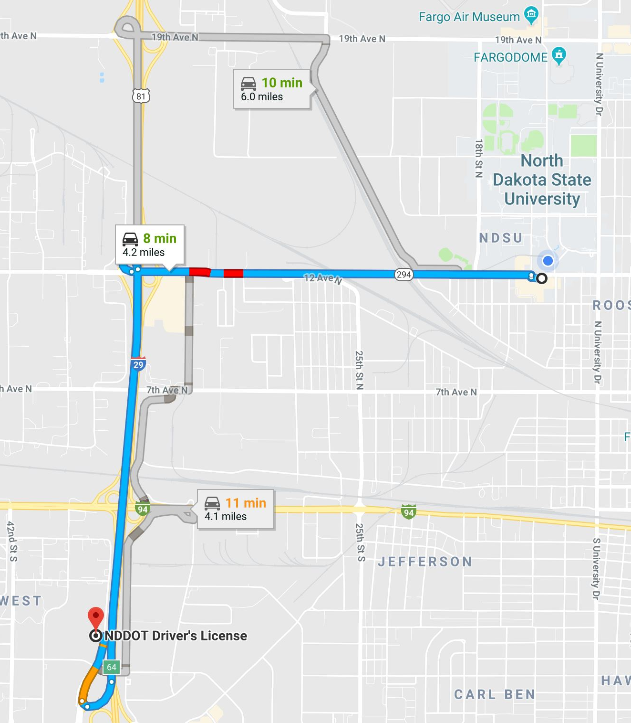
Getting to the DMV
Booking an appointment for a license: https://www.legis.nd.gov/lcn/assembly/constituentViews/public/findmylegislator.htm
Both the Democratic-NPL and Republican Coordinated Campaign offices can provide rides to the DMV.
  Democratic-NPL: (701)805-6063
  Republican: (701)360-2053

Slide 8
“But I don’t know enough to vote.”
You can learn!
This sample ballot will let you know what will be on your ballot and give you information on the candidates and issues! https://ballotpedia.org/Sample_Ballot_Lookup
Your vote matters, and you don’t have to be an expert to voice your opinions!

Slide 9
ND Ballot Measure 1:
Ethics Commission, Foreign Political Contribution Ban, and Conflicts of Interest Initiative
If enacted, would
Establish a five-member ethics commission with members chosen by the Governor, the Senate Majority Leader, and the Senate Minority Leader
Ban political contributions from foreign entities, governments, and individuals
Create restrictions on lobbyists regarding gifts, contributions, and qualifications
Create provisions designed to prevent conflicts of interest for government officials
Require campaign finance information to be publicly accessible

Slide 10
ND Ballot Measure 2:
Citizen Requirement for Voting Amendment Initiative
If enacted, would
Amend Article II of the ND Constitution
  Change language from “every citizen” of the United States is a qualified elector to “only a citizen” of the United States is a qualified elector
  Add a Section III to Article II, which reads: “Only a qualified elector may vote in any general, special, or primary election for a federal, statewide, state legislative, district, county, township, city, or school district office, or for a statewide, district, or political subdivision ballot measure.

Slide 11
ND Ballot Measure 3:
Marijuana Legalization and Automatic Expungement Initiative
If enacted, would
Legalize the recreation use of cannabis in the state of North Dakota for individuals 21 years of age or older
Create penalties for the possession or distribution of cannabis to or by individuals under 21 years of age
Create an automatic expungement process for individuals with convictions for a controlled substance that has been legalized
Eliminate the state of North Dakota’s immunity from damages resulting from expungement lawsuits

Slide 12
ND Ballot Measure 4:
Special License Plates and Free Access to State Parks for Volunteer Emergency Responders Initiative
If enacted, would
Require that personalized license plates be provided to volunteer emergency responders, such as volunteer firefighters and emergency medical service volunteers
The license plates would allow volunteer emergency responders into state parks free of charge

Slide 13
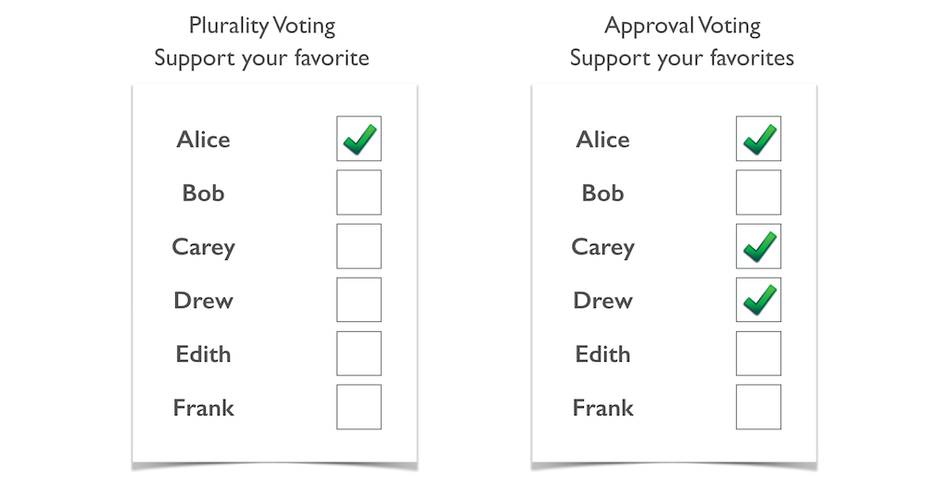
Fargo Measure 1:
Approval Voting Amendment of the Home Rule Charter for the City of Fargo
If enacted, would
Amend the city charter to allow voters to vote for all the candidates of which they approve for each open seat.
Impact elections for City Commission, mayor, and municipal judges
The current method, “plurality voting,” allows voters to vote for one candidate per open seat.

Slide 14
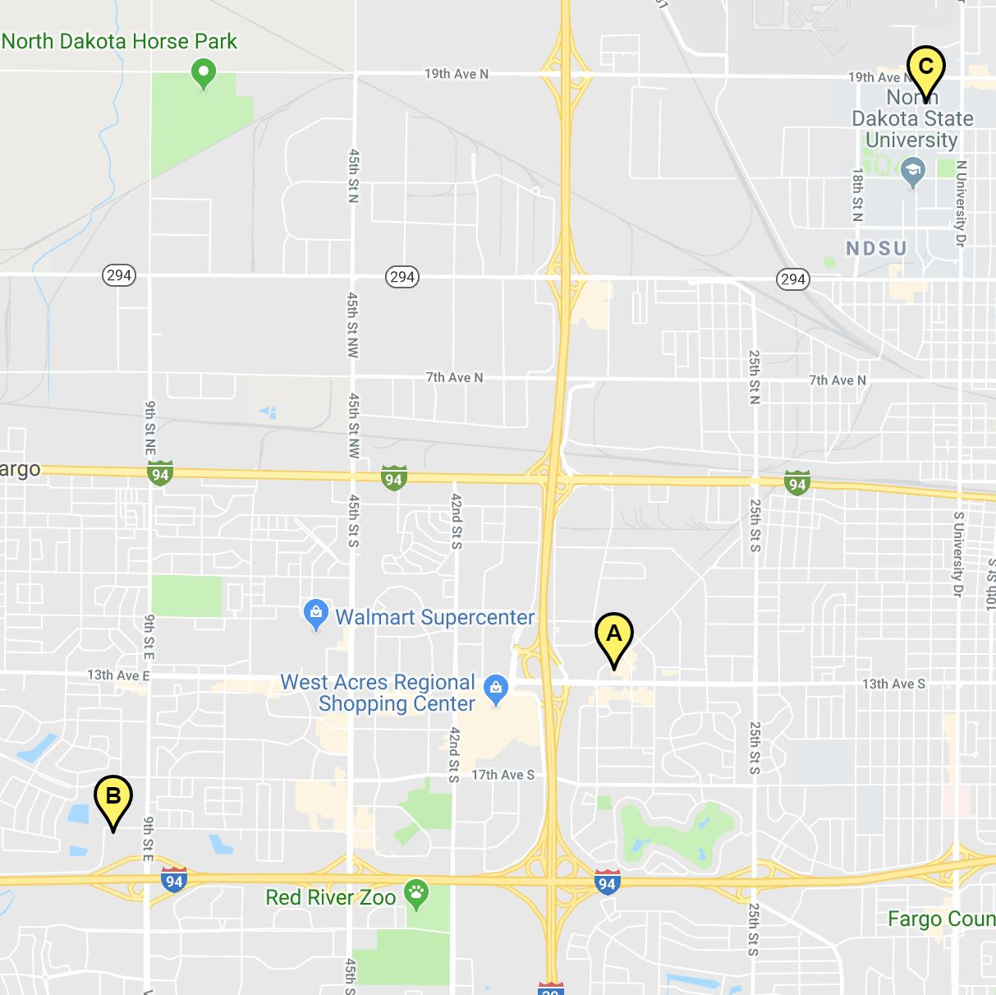
Early Voting
Oct. 29th-Nov. 2nd
Early voting is convenient because anyone from any district can vote at these locations all week!
10:00 AM – 7:00 PM
FARGODOME:
  1800 University Drive North Fargo, ND 58102
Ramada Inn:
  3333 13th Avenue South Fargo, ND 58103
Ramada Inn:
  825 East Beaton Drive West Fargo, ND 58078

Slide 15
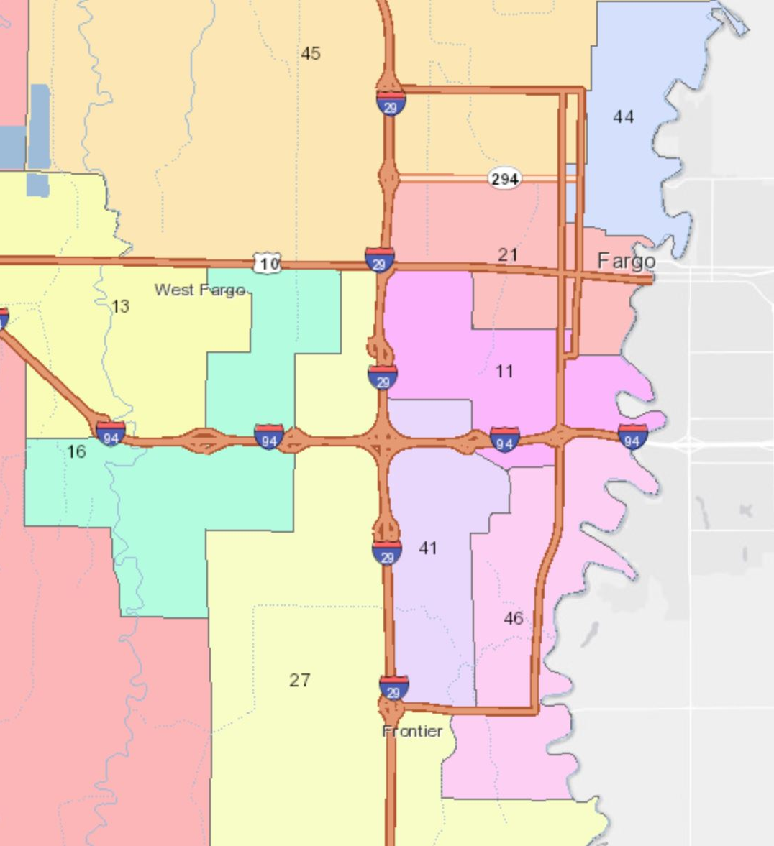
Your District, Legislators, and Polling Location
District and Legislators: https://www.legis.nd.gov/lcn/assembly/constituentViews/public/findmylegislator.htm
Polling Location: https://vip.sos.nd.gov/wheretovote.aspx
Interactive District Map: https://ndgov.maps.arcgis.com/apps/StorytellingTextLegend/index.html?appid=cc1cd59ae12c49af802fd73eabaa82b7

Slide 16




Rides to the Polls
Uber and Lyft are offering free and discounted rides to the polls
Party Campaign Offices will give free rides
  Republican: (701)360-2053
  Democratic-NPL: (701)805-6063
This Photo by Unknown Author is licensed under CC BY-SA
This Photo by Unknown Author is licensed under CC BY-ND

Slide 17
NDSU Student Government urges you to vote in the
2018 midterms
If you have any questions, reach out to
Landen Einarson
Executive Commissioner of External Affairs
landen.j.einarson@ndsu.edu
Joseph Vollmer
Assistant Executive Commissioner of External Affairs
joseph.r.vollmer@ndsu.edu

